Slide 1

STRAVA FITNESS DATA ANALYTICS
By- Prashant Kumar Singh

Slide 2
1) PYTHON : DATA CLEANING AND VISUALIZATION
2) SQL : DATA QUERY
3) POWER BI: DASHBOARD

Slide 3
DATA CLEANING
The dataset contains multiple CSV files tracking users' physical activity, sleep, heart rate, and other health metrics. Before analysis, it was crucial to clean, unify, and structure the data to ensure consistency and remove errors or redundancies.

Slide 4
Datasets Used
The following CSV files were imported and cleaned:
dailyActivity_merged.csv
dailyCalories_merged.csv
dailyIntensities_merged.csv
sleepDay_merged.csv
weightLogInfo_merged.csv
heartrate_seconds_merged.csv
HourlySteps_merged.csv
HourlyCalories_merged.csv
HourlyIntensities_merged.csv

Slide 5
Cleaning Steps
a. Date-Time Conversion
To ensure consistency in time-based operations and merging:
Converted all relevant date columns to datetime format.
Extracted Date and Hour fields for hourly datasets.
b. Duplicate Removal
Used .drop_duplicates() to eliminate duplicate entries in all datasets. This prevents bias and redundancy during analysis.

Slide 6
Cleaning Steps
c. Column Renaming
Renamed date columns across datasets to a common column (Date) for smooth merging.
d. Dropping Unnecessary Columns
Dropped columns with excessive missing data (e.g., Fat in weight log).
Dropped columns that were redundant after merging (e.g., _y columns after merging intensity and calories with daily activity).
Dropped WeightKg, WeightPounds, BMI, IsManualReport, and LogId from final merged DataFrame to simplify the dataset.

Slide 7
Cleaning Steps
e. Merging Data
Performed multiple merges to combine daily data into one DataFrame (df):
Daily calories
Daily intensities
Sleep data
Weight data
For hourly-level data, merged:
Hourly steps
Hourly calories
Hourly intensities
Hourly averaged heart rate
Created separate DataFrames:
df_sleep: subset of df containing only rows with valid sleep data.
hr: subset of hourly_merged containing only rows with valid heart rate values.

Slide 8
Final Cleaned DataFrames
df: Cleaned and merged daily-level data.
df_sleep: Subset of df with valid sleep data.
hourly_merged: Hourly-level activity, calorie, and heart rate data.
hr: Hourly-level data with heart rate available.

Slide 9
Visualization

Slide 10
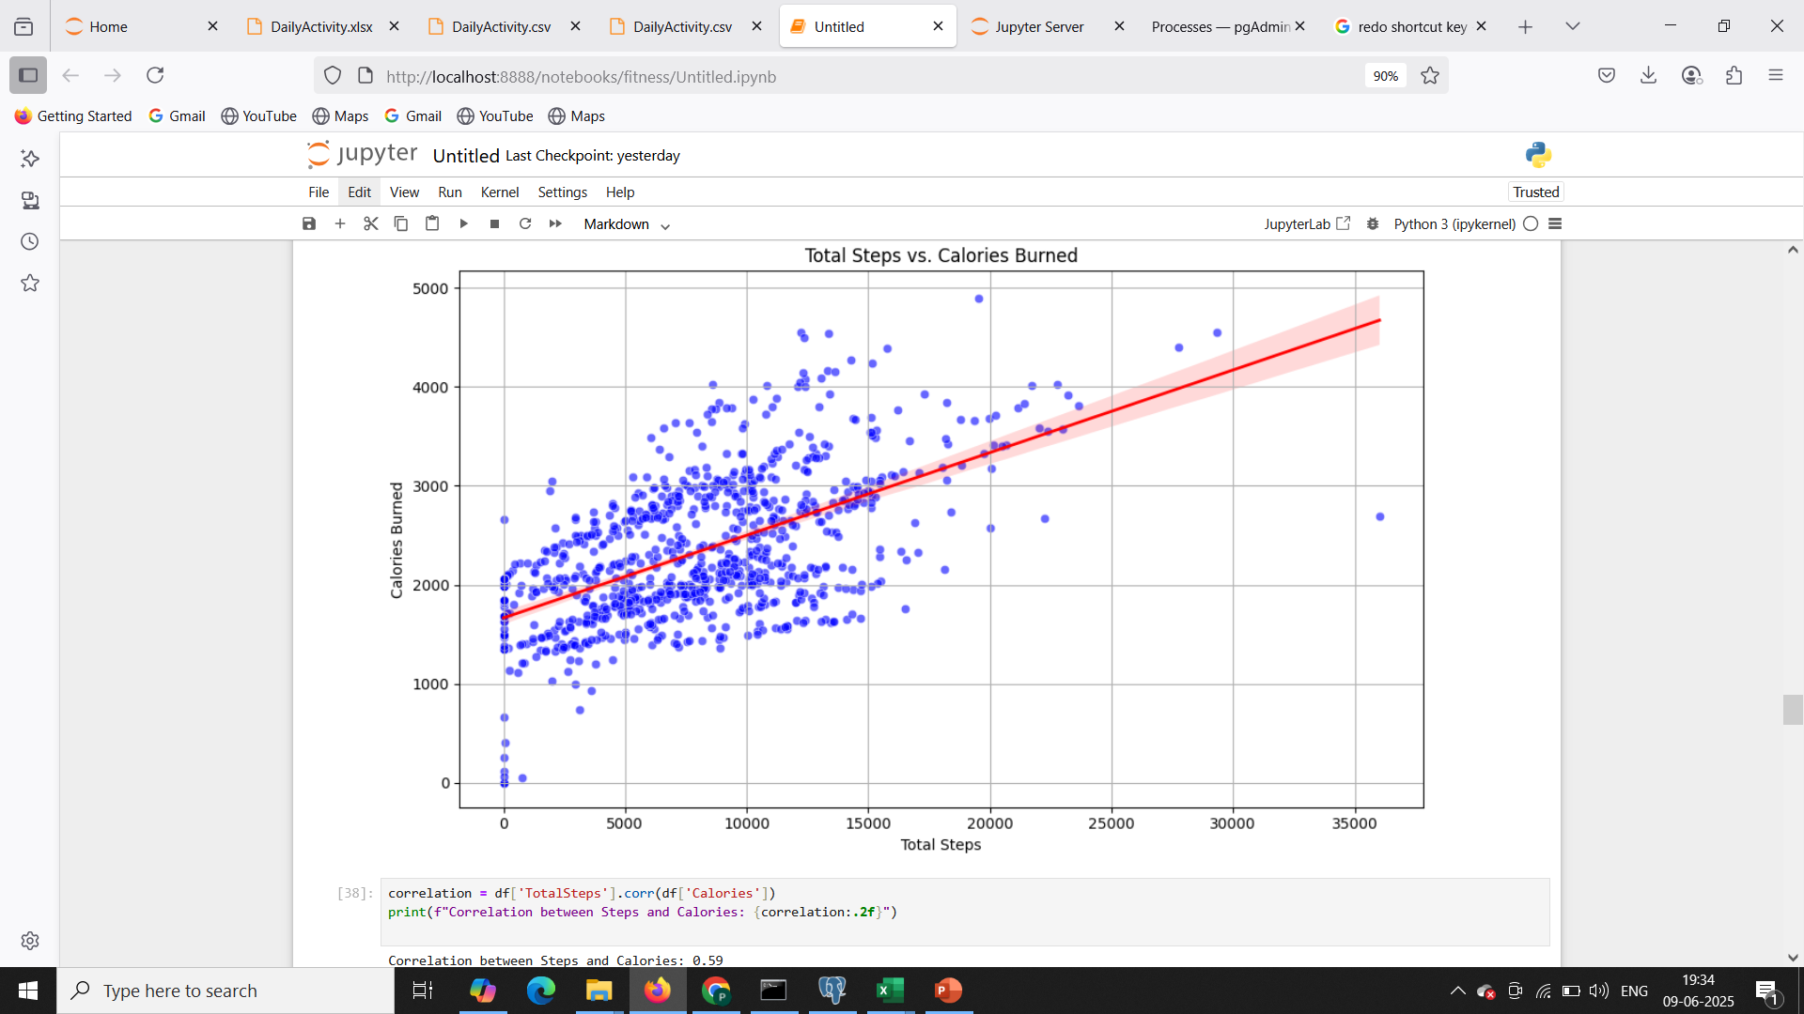
1. Daily Steps vs. Calories Burned (Scatterplot , regression plot)

Slide 11
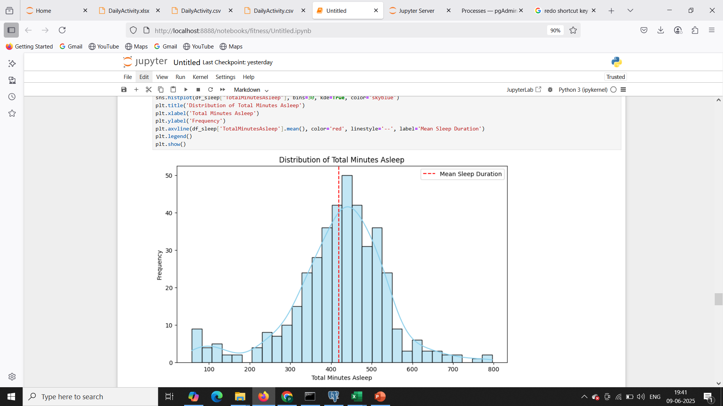
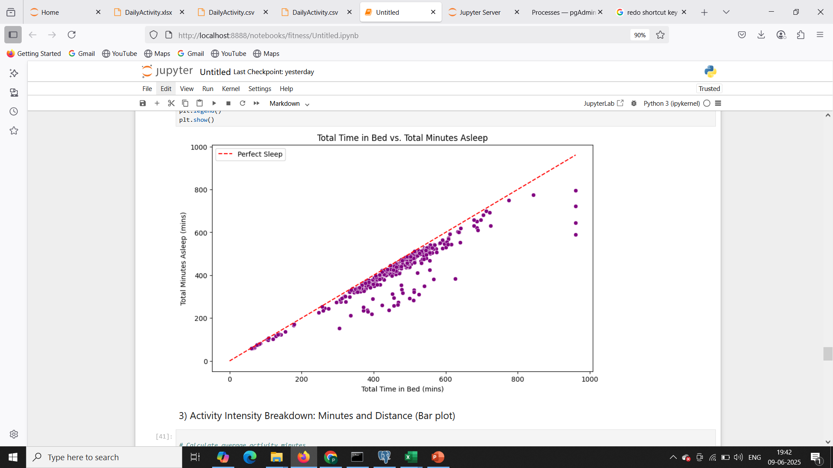
2. Sleep Duration Distribution and Quality Analysis (Histogram, Scatter plot)

Slide 12
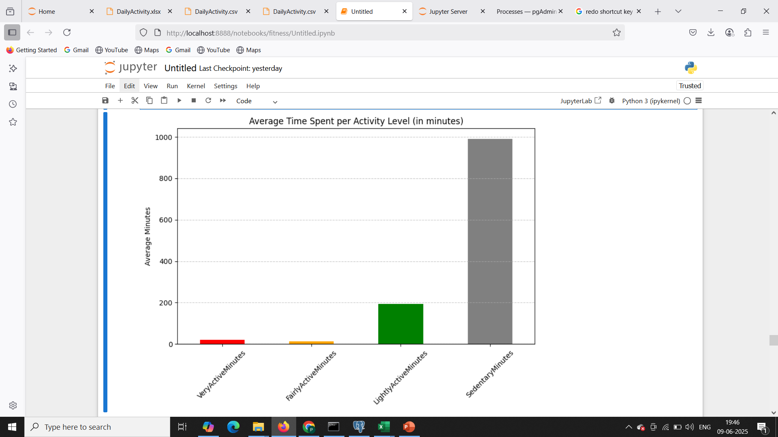
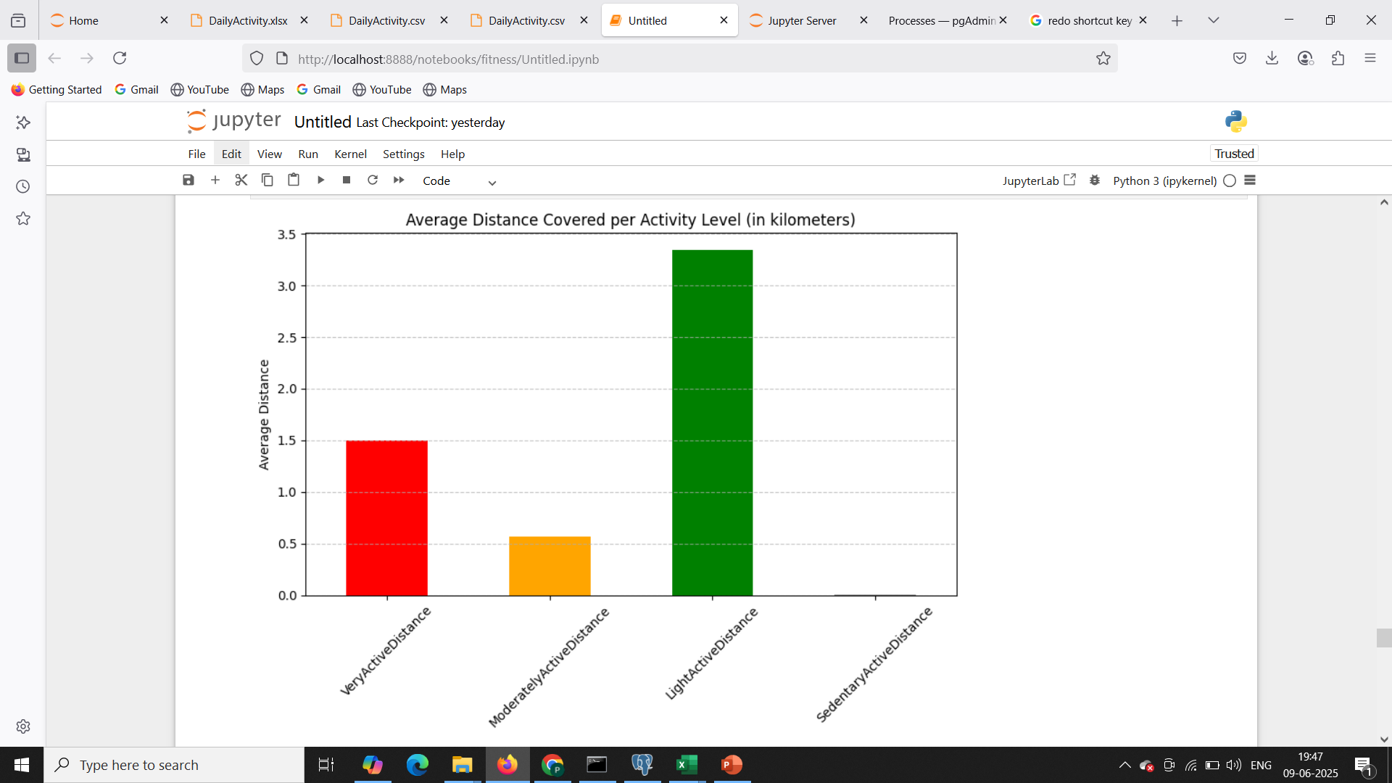

3. Activity Intensity Breakdown: Minutes and Distance (Bar plot)

Slide 13
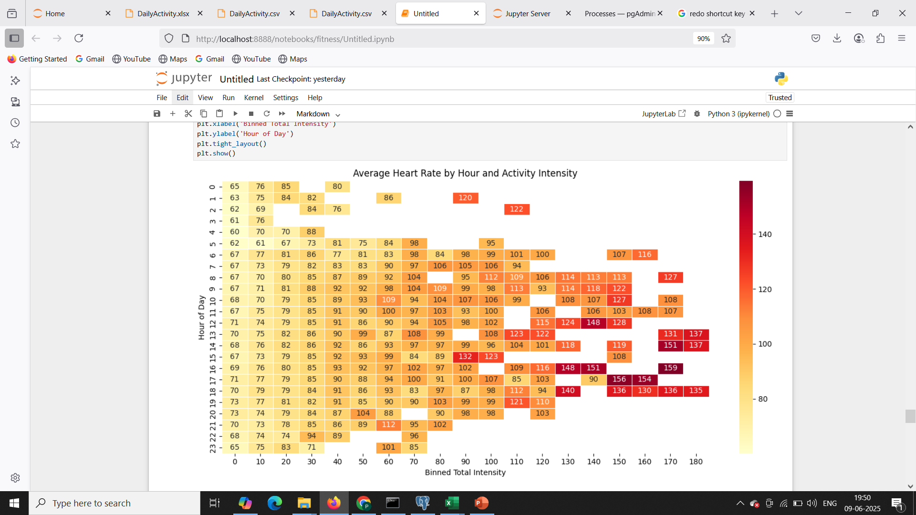
4.Hourly Activity Intensity vs. Heart Rate (Heatmap)

Slide 14
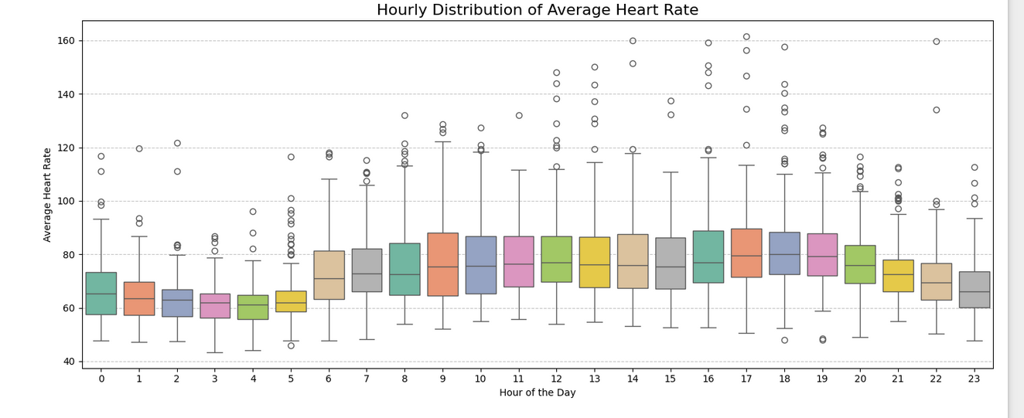
5. Hourly Distribution of Average Heart Rate (Box plot)

Slide 15
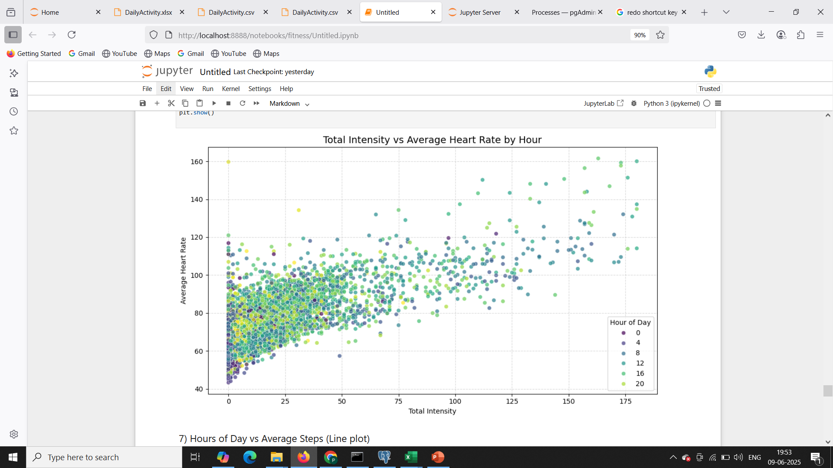
6. Total Intensity vs Average Heart Rate (Scatter plot)

Slide 16
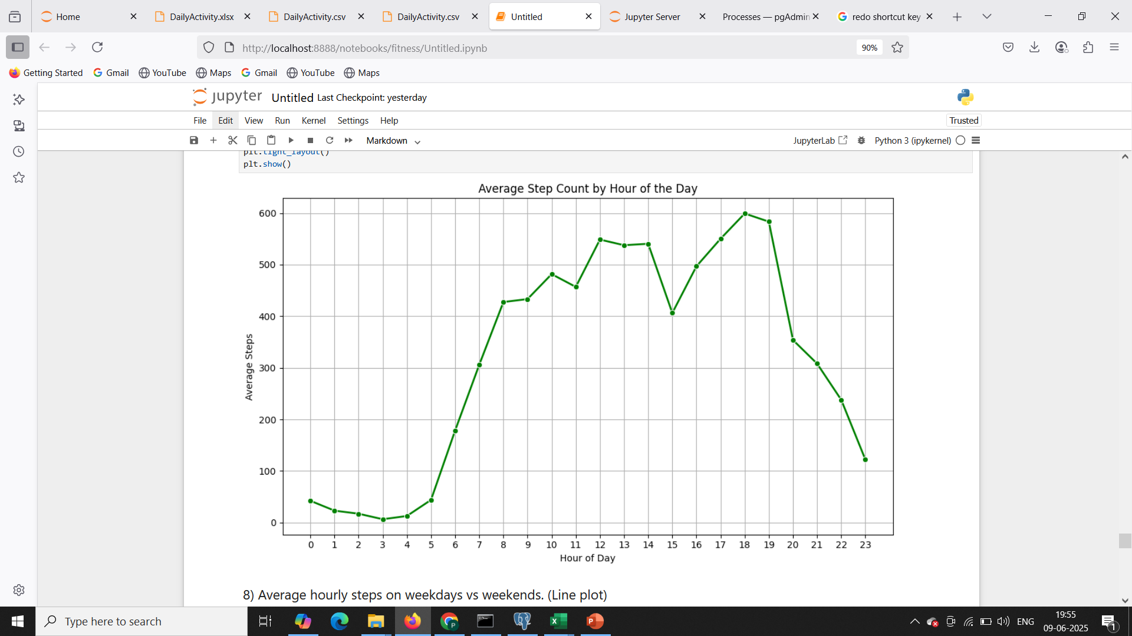
7. Hours of Day vs Average Steps (Line plot)

Slide 17
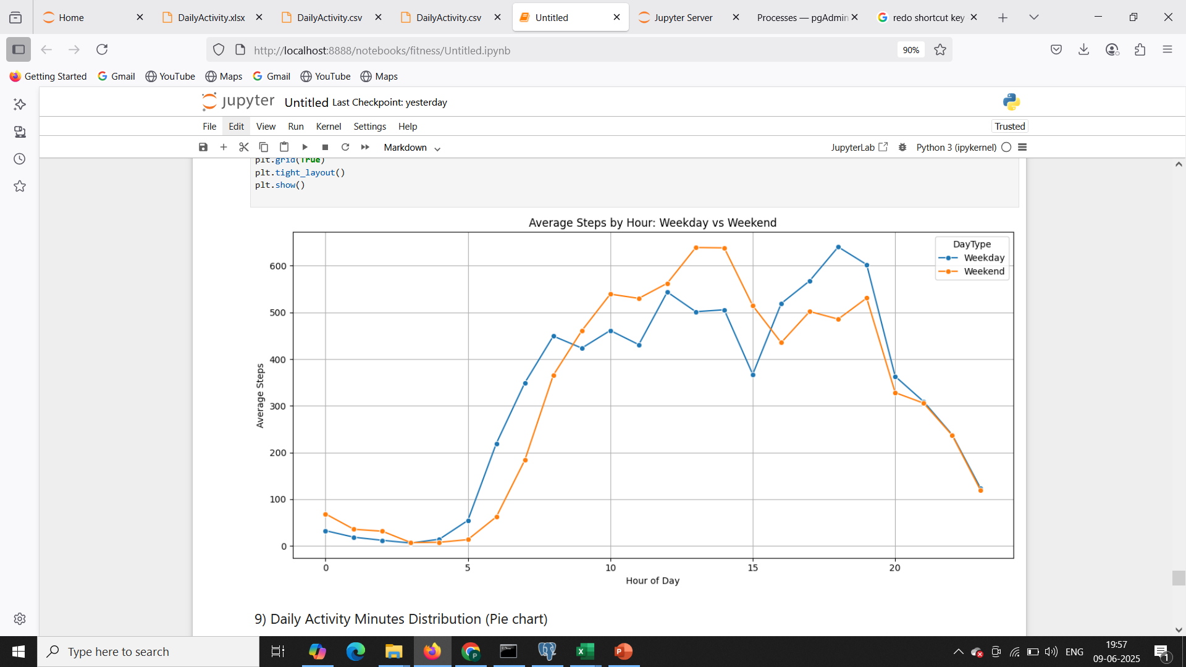
8. Average hourly steps on weekdays vs weekends. (Line plot)

Slide 18
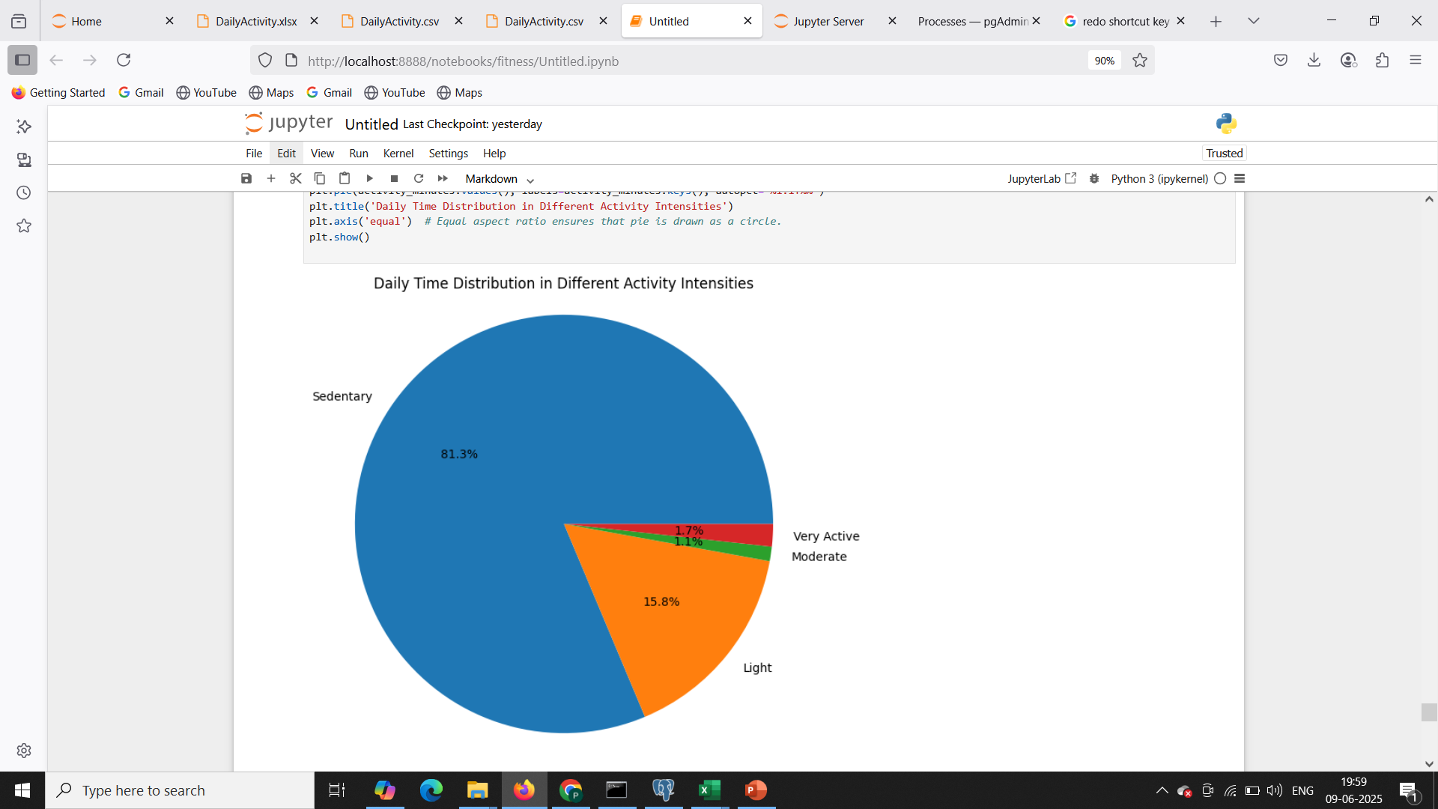
9. Daily Activity Minutes Distribution (Pie chart)

Slide 19
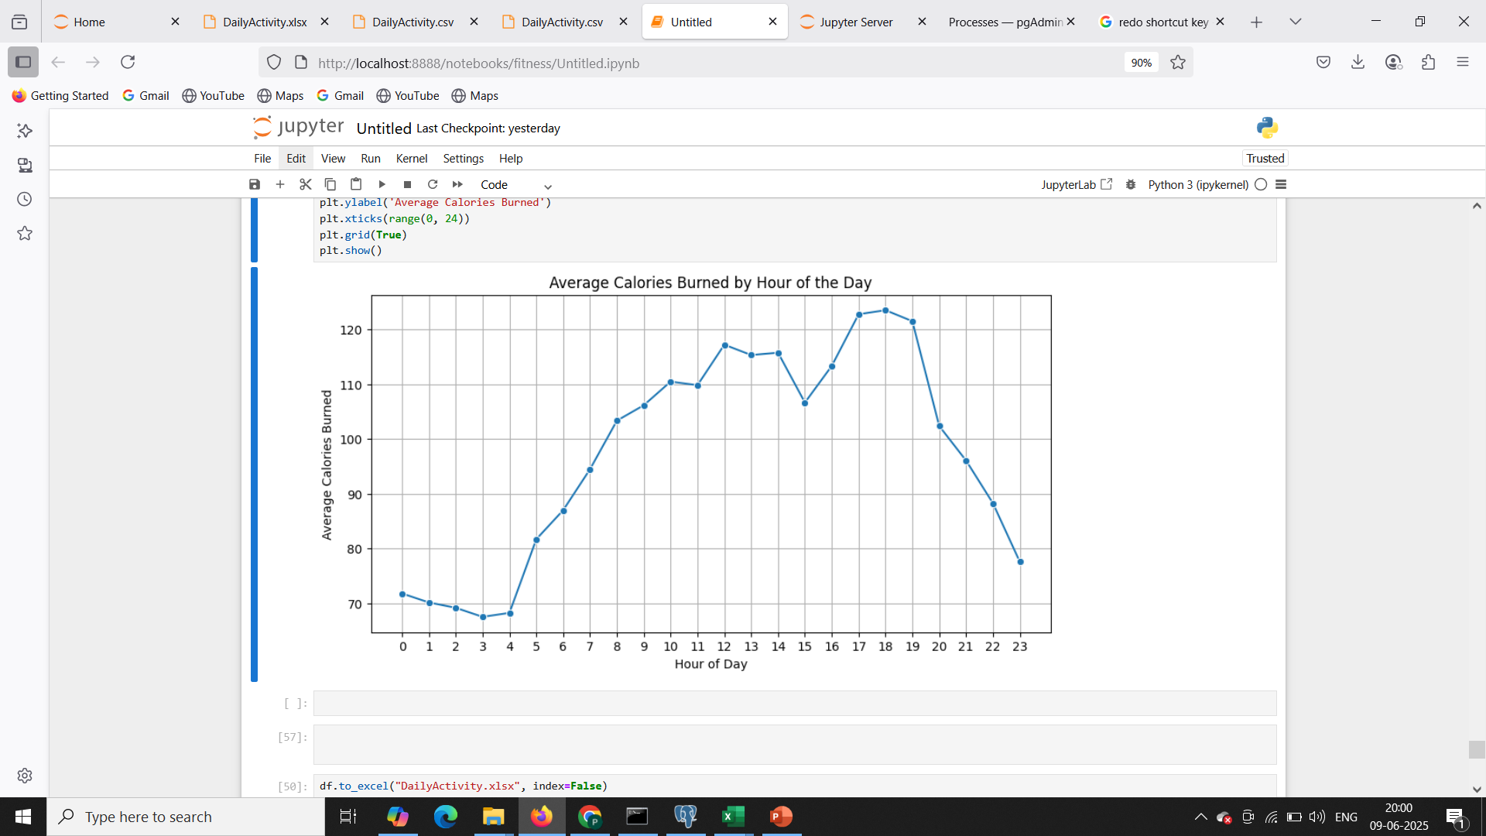
10. Calorie Burn Patterns by Hour of the Day (Line plot)

